Slide 1
Enrolling to CS50 Course - Introduction to Databases with SQL and Submitting a Problem Set
Prof Dr Melike Şah Direkoğlu

Slide 2
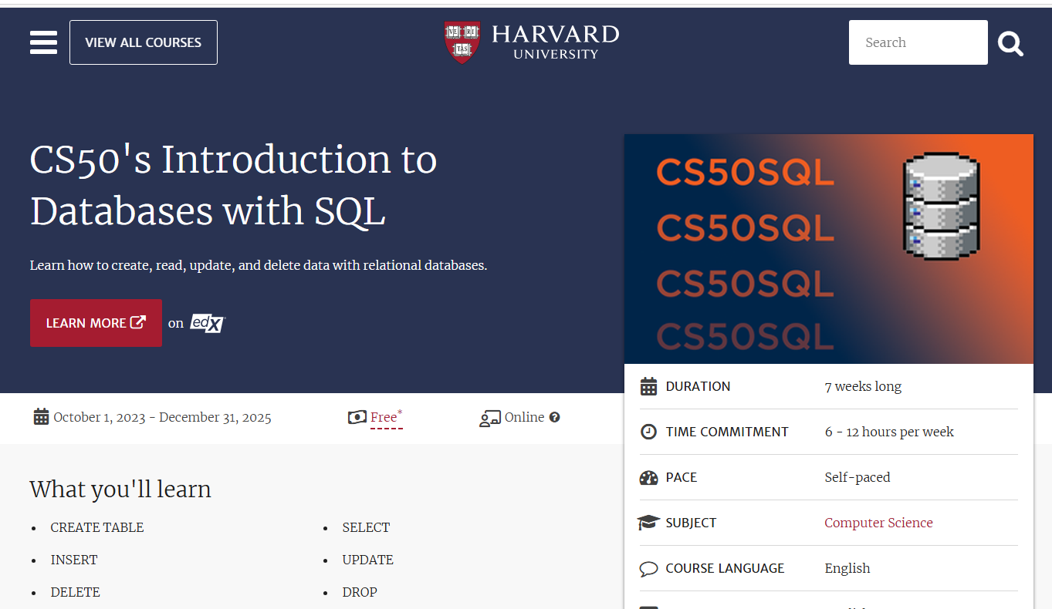
First Enroll to the Course
Go to https://pll.harvard.edu/course/cs50s-introduction-databases-sql

Slide 3
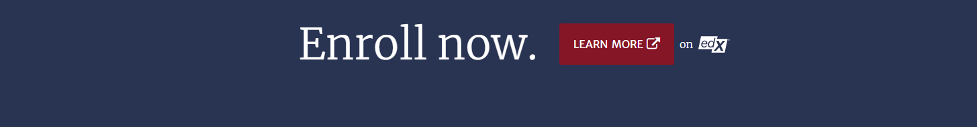
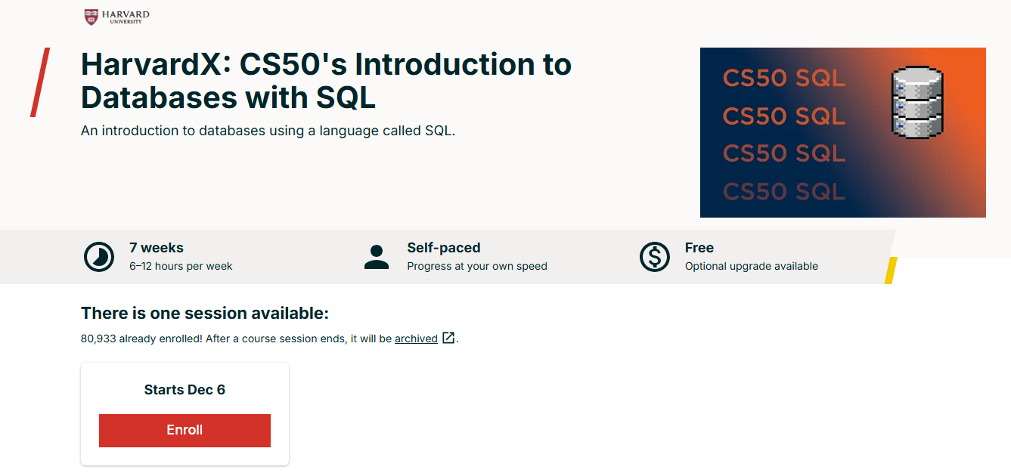
Click LEARN MORE and on the new page opened, click ENROLL!

Slide 4
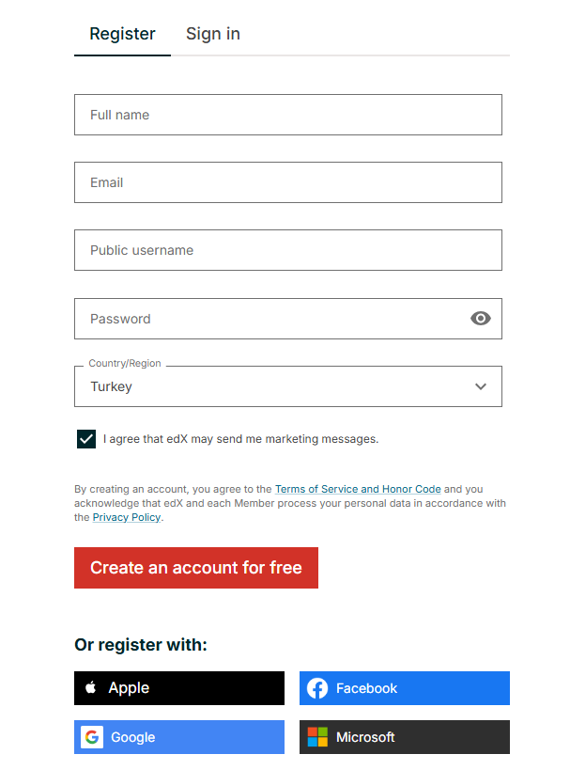
edX Platform
Enroll will direct you to the edX platform. You can see course materials and submit problem sets using edX!
If you already registered to edX, just login. Otherwise, you need to register. Register with ciu student email addresses!
22113344@student.ciu.edu.tr
https://student.ciu.edu.tr/?loginOp=relogin&client=standard&loginErrorCode=service.AUTH_REQUIRED (to login to your student emails)

Slide 5
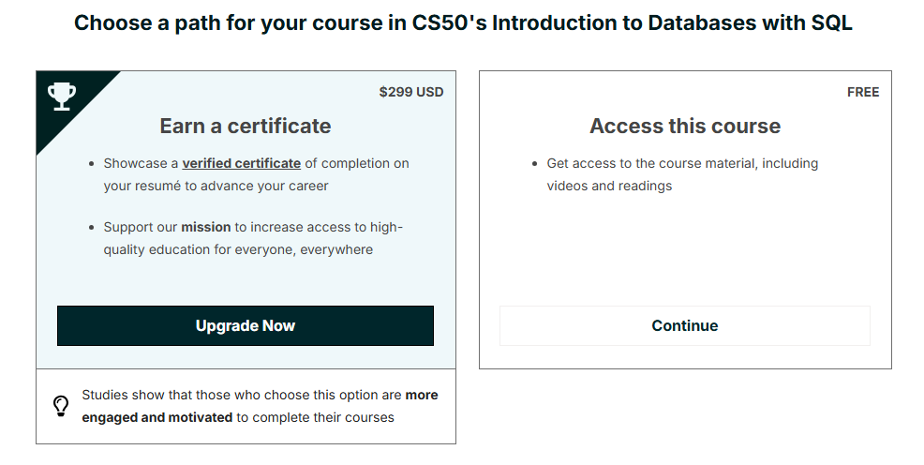
After registering and login to edX, click continue under ‘Access this course’

Slide 6
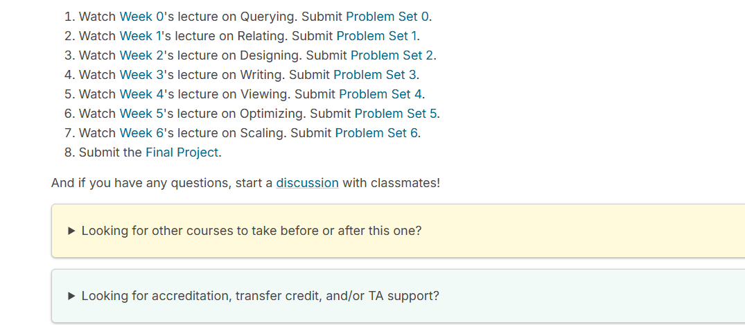
Access to CS50 Course Lectures and Problem Sets
In the lab, we will submit Problem Set 0 – Cyberchase problem set (in the week of 16-20 December)

Slide 7
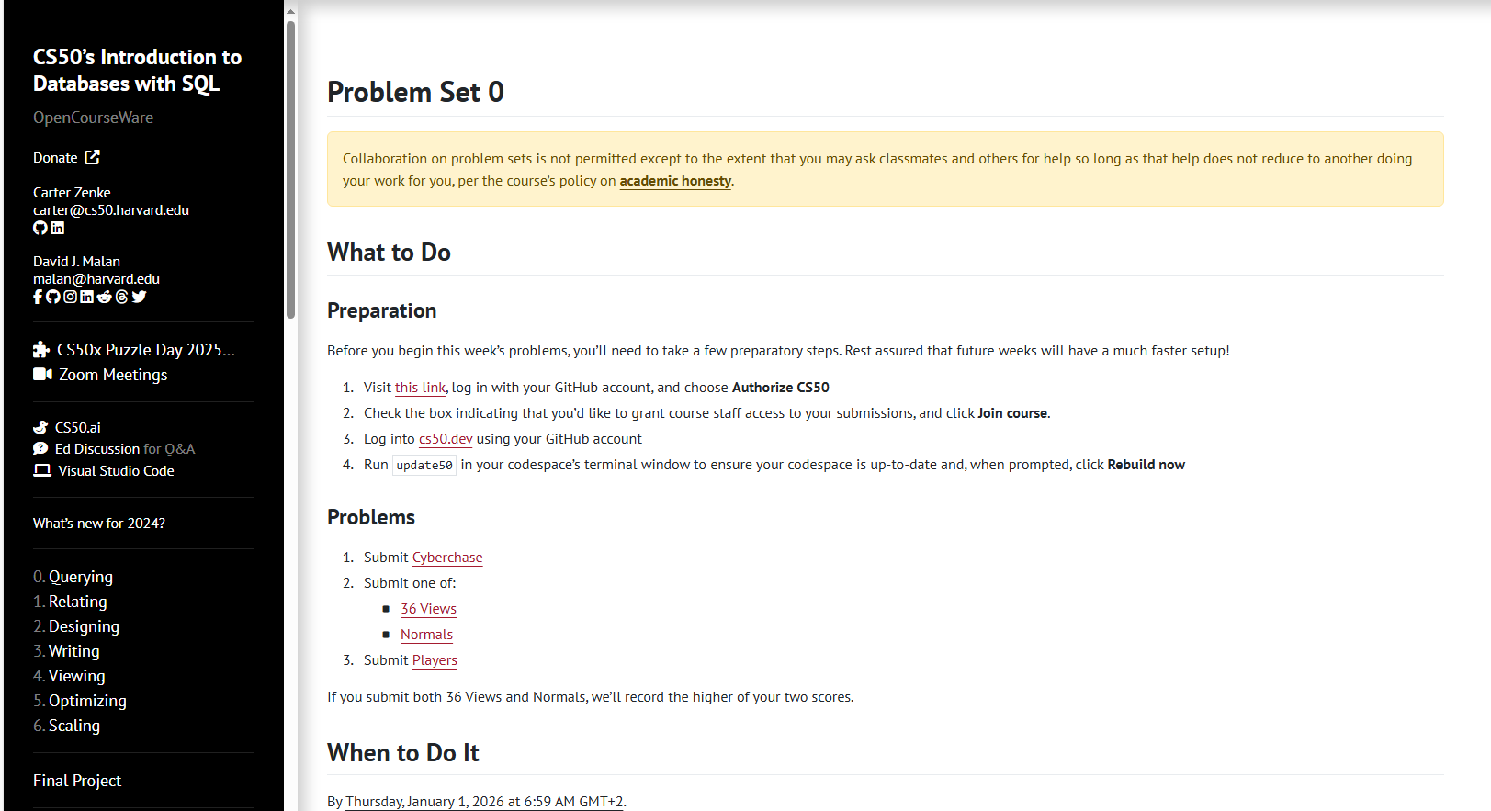
Problem Set 0 – First preparation!

Slide 8
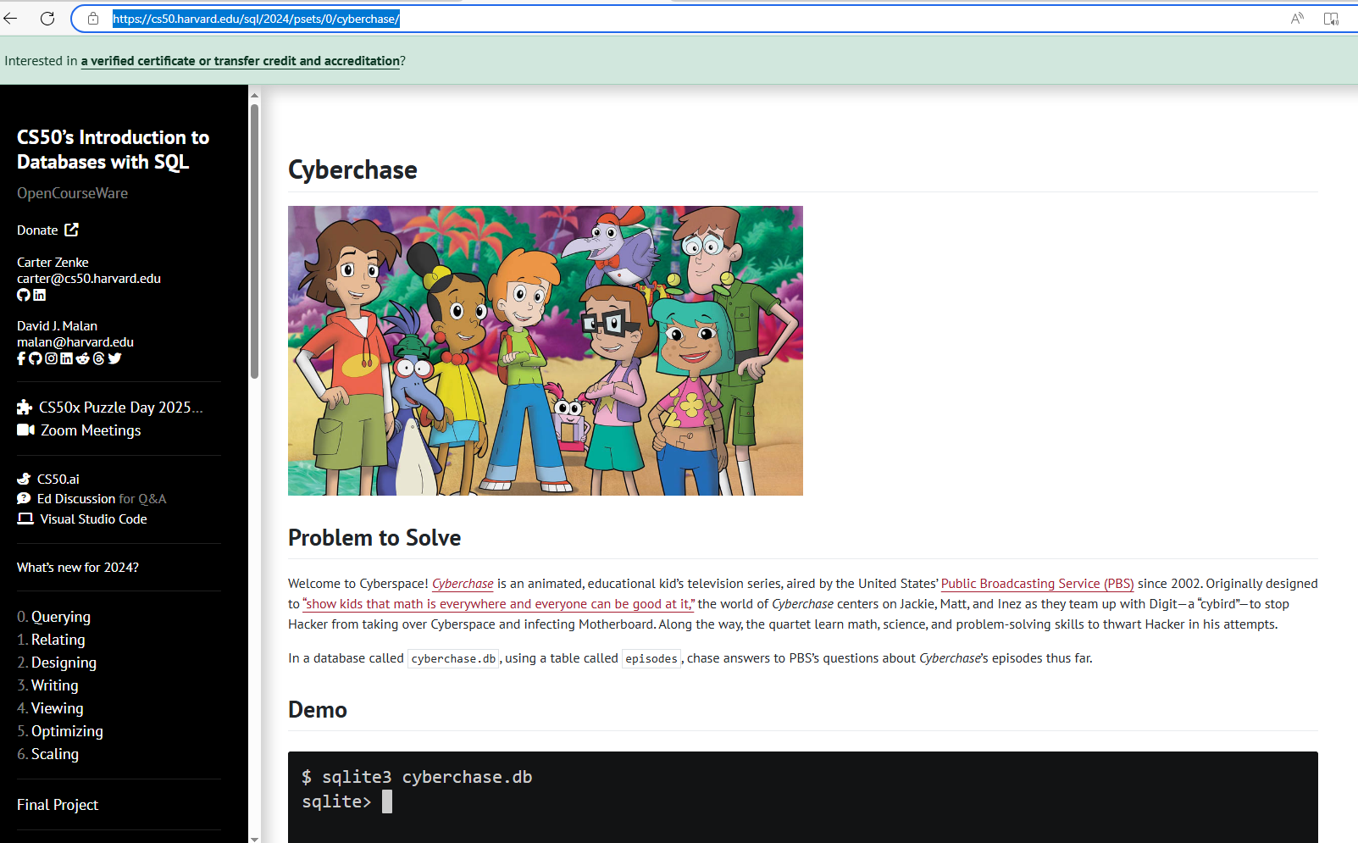
Cyberchase problem set (https://cs50.harvard.edu/sql/2024/psets/0/cyberchase/ )

Slide 9
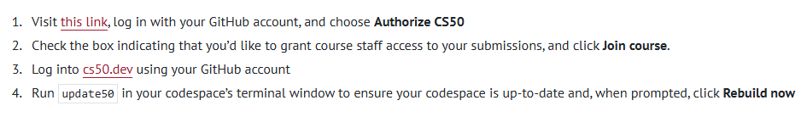
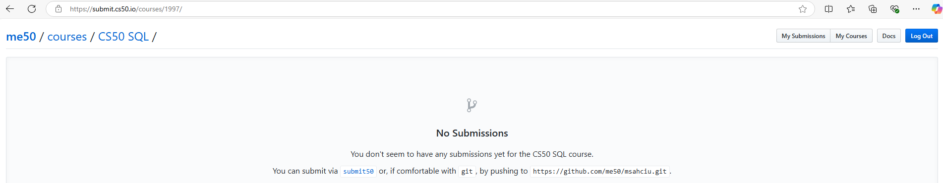
Step 1 - Register and then Login to GitHub using ‘this link’
Step 2 - After logining to GitHub, it will ask you to grant access to CS50. Confirm it (I cannot see these steps since I have already done it before)
Then you will see the page below. Click my courses!

Slide 10
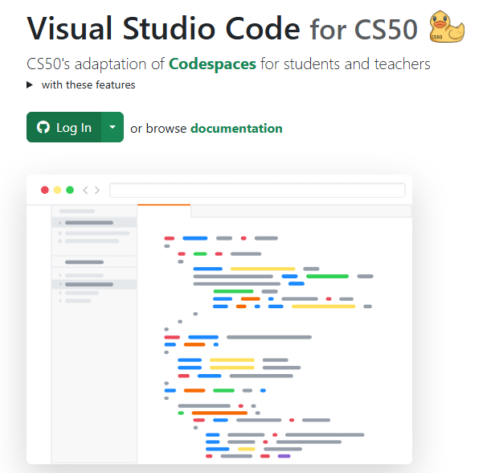
Step 3 – Login to cs50.dev using your GitHub account

Slide 11
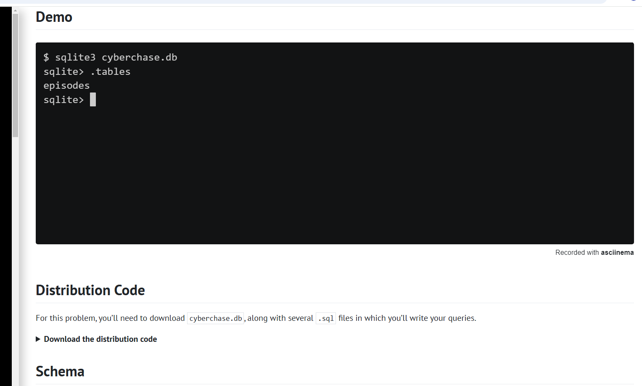
After you logged in, initially cyberchase.db and sql files cannot be seen!
Follow the steps on cyberchase problem set as follows:
Click download the distribution code for instructions

Slide 12
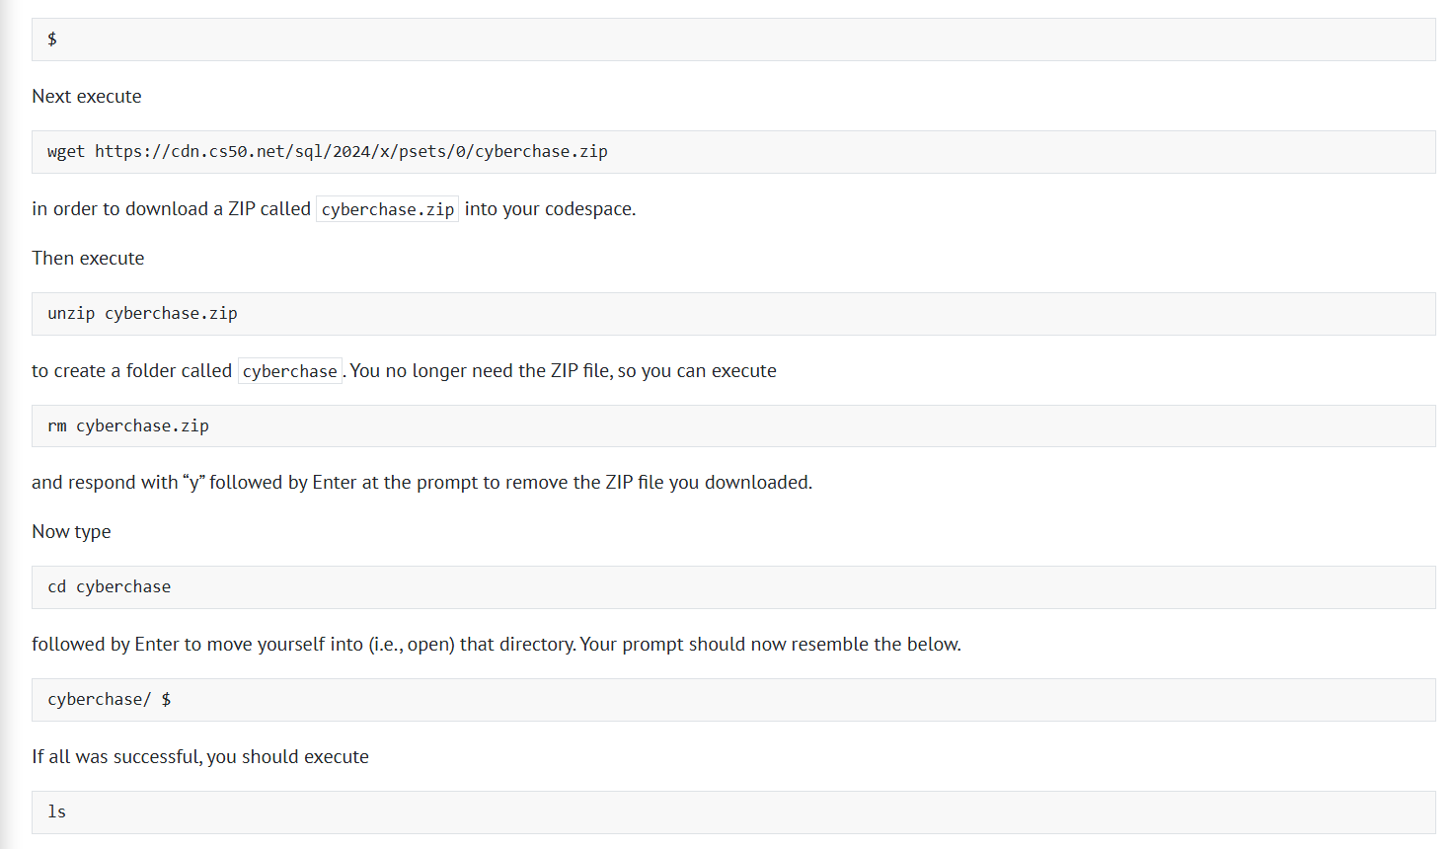
Go and login to codespaces (cs50.dev)
In the terminal below, copy and paste these commands!

Slide 13
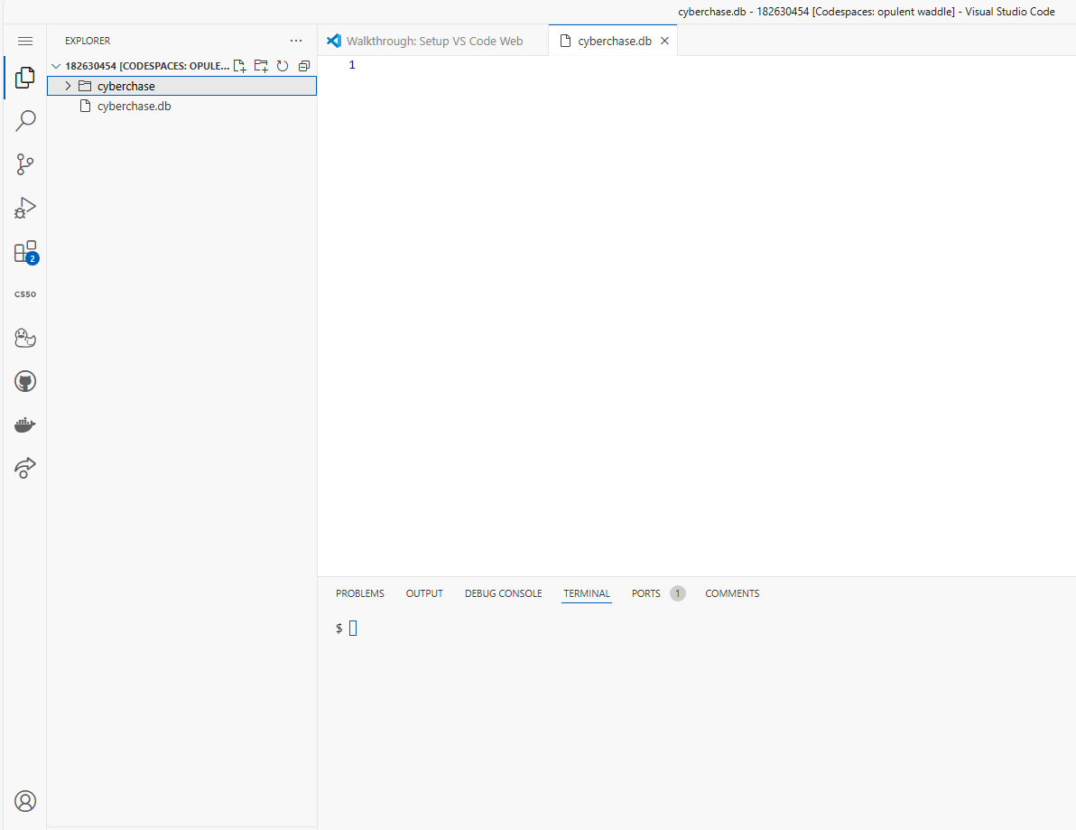
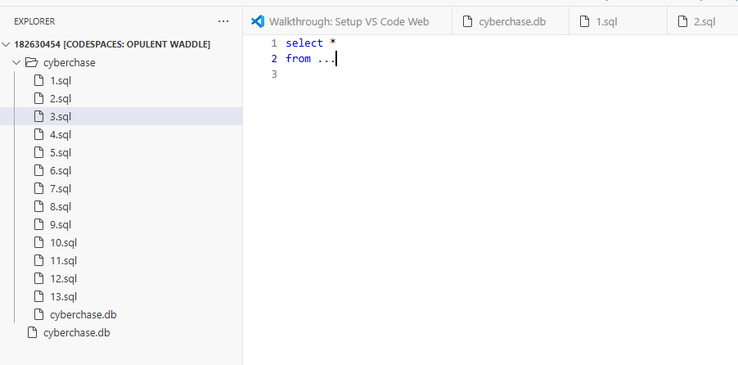
Now you can access to cyberchase.db and write your SQL queries to the given . sql files!
Unfold your cyberchase folder. You will see 13 queries in the format of 1.sql etc. Click one of them, it is empty! You will write the sql queries according to the question in problem set 0 – Cyberchase problem!
Click query files to edit in the editor
TEXT EDITOR

Slide 14
Before writing any queries, finally, register to CIU CS50 Courses!
So that we can see/access your submissions!

Slide 15
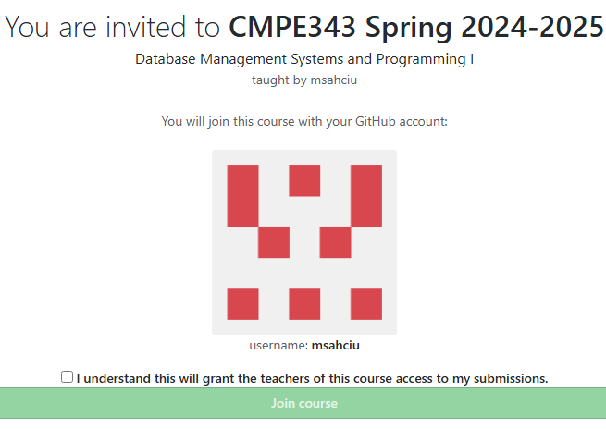
CMPE343 Students (Database I)!
If you are taking CMPE343, click to register CMPE343 CS50 course below so that I can see your submissions!
https://submit.cs50.io/invites/1ab3cf84e61c4d62943e807c71cab30e

Slide 16
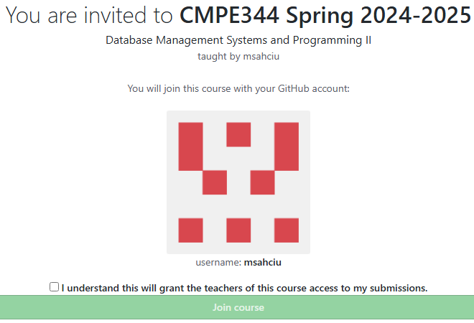
CMPE344 Students (Database II)!
If you are taking CMPE344, click to register CMPE344 CS50 course below so that we can see your submissions!
https://submit.cs50.io/invites/7e1bbf4692544064b9e29d68793f7a79

Slide 17
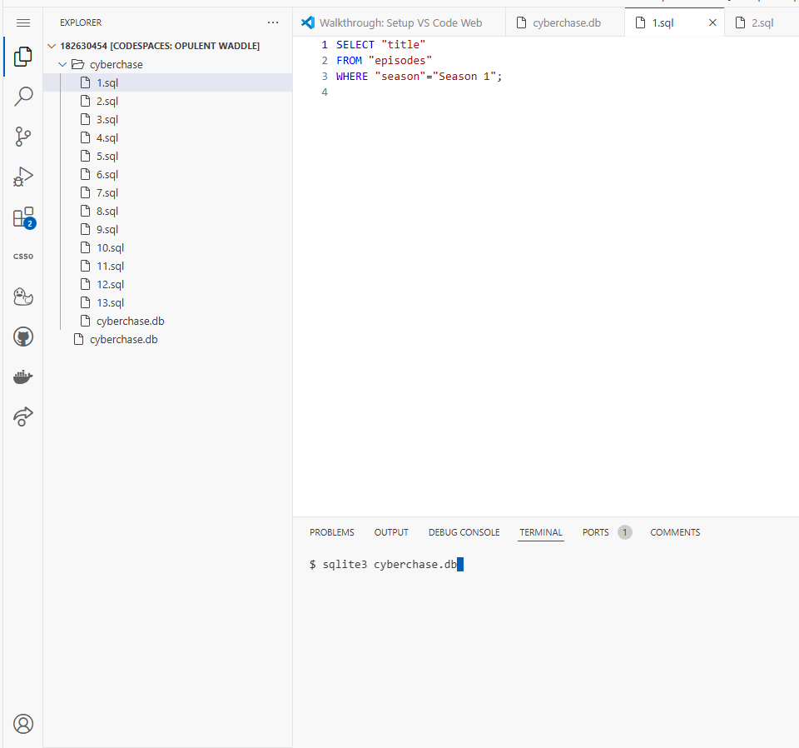
Now write your queries in codespaces (cs50.dev)
Edit 1.sql in the editor. Use the answer at the right!
Then at the terminal below, first update cs50 by writing and using cyberchase.db
$ update50
$ sqlite3 cyberchase.db
Will change the folder to
sqlite $
Then edit the queries and test the results using the instructions on https://cs50.harvard.edu/sql/2024/psets/0/cyberchase/

Slide 18
Checking and submitting your queries
After writing 1.sql in the terminal write the following command (.quit)
Sqlite $ .quit
That will change to $
In the $, write command cd cyberchase
$ cd cyberchase
Now, you can check the correctness of your queries using following:
cyberchase $ check50 cs50/problems/2024/sql/cyberchase

Slide 19
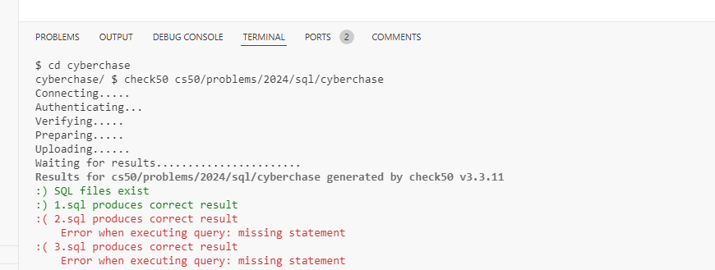
Smiley faces indicate that your query is correct.
Continue writing the rest of the queries in the lab (16-20 December)!

Slide 20
Finally, after completing all queries “in the lab”, submit the problem set
cyberchase $ submit50 cs50/problems/2024/sql/cyberchase
MAKE SURE YOU REGISTER TO the corresponding CIU CS 50 BEFORE SUBMITTING!
CMPE344 students will submit different problem sets! This is just a demo!

